Slide 1
DATASCIENCE PROJECT

Slide 2
INTRODUCTION TO MAIN PROJECT
The system we have been working with in this project is DataScience and Machine Learning.Here we implemented K-means clustering one of the Unsupervised learning techniques of Machine learning Algorithms.
In this activity,we will be introduced to K-means and its uses cases in forming clustering of related data.

Slide 3
TOOLS AND TECHNOLOGIES USED
JUPUTER NOTEBOOKS:
Jupyter Notebook is a powerful, collaborative, easy-to-use platform that helps you and your team
It has individual cells for every line of code and can execute independently and becomes user friendly for new users.

Slide 4
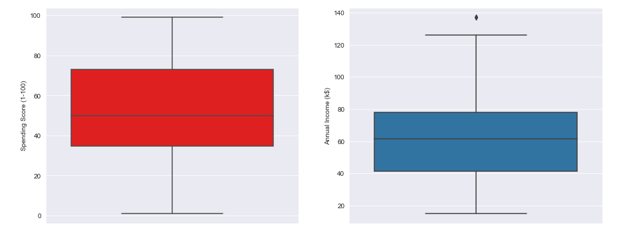
Intitial Learnings from data

Slide 5
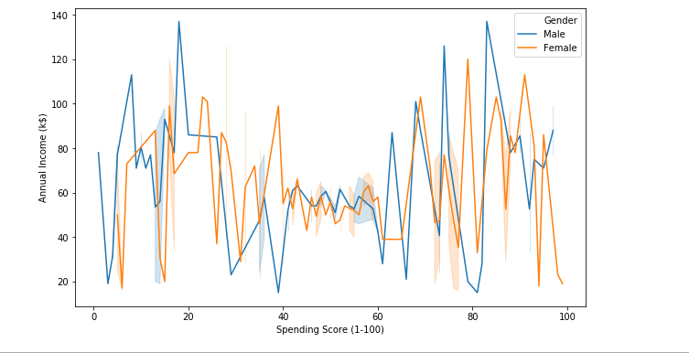

Slide 6
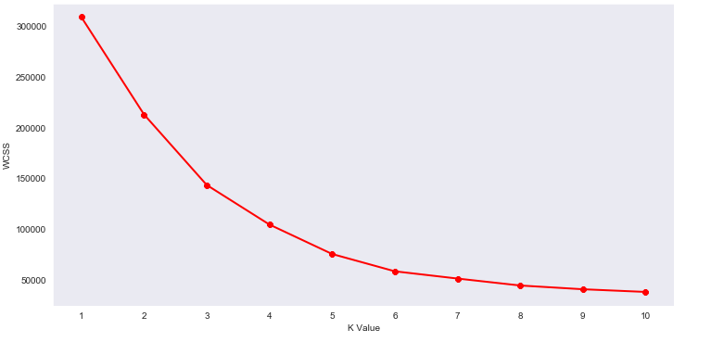

Slide 7
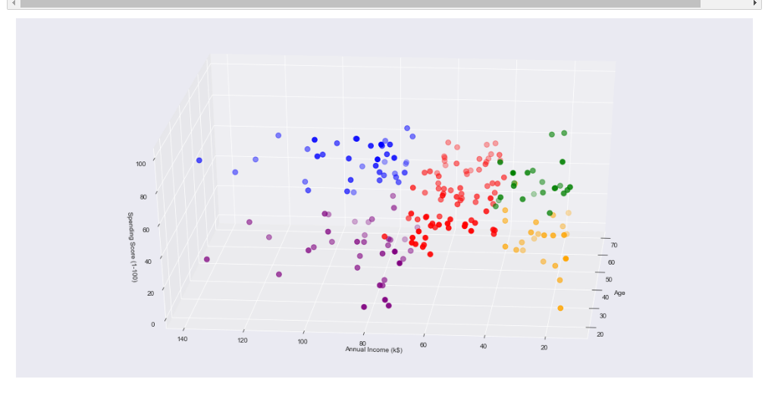
FINAL CLUSTERS

Slide 8
CONCLUSION
In our project work, an attempt has been to form clusters of people based on previous data records and group new unseen data of people and group them into a cluster based on various factors of new people we are trying to categorize. To establish this website we use various methodologies. To develop this project we have faced many problem but we hardly tried to develop this project. Our supervisor helps us by giving his valuable opinion, decision and time.

Slide 9
CONTACT US:
Website
http://www.exposysdata.com/ Industries
Computer Software
Company size
11-50 employees
Headquarters
Bengaluru, Karnataka
Type
Public Company
Founded
2019
Locations
Primary
P.M R. Residency Ground Floor
Singanayakanahalli, Yelahanka Bengaluru, Karnataka 560064 Bengaluru, Karnataka 560064, IN

Slide 10
THANK YOU
FROM:
K.Bhanu Prasad
J.Akhil

